Slide 1
University 2012 The Transformation Project of the Capgemini University
A monthly update to inform the University Team
August / September 2010

Slide 2
Introduction
As the summer comes to an end and people start coming back from holiday, the University Transformation Project is all set to move into its next phase!
The first quarter of 2010 saw the project being set up with the objectives, work streams and teams being identified. In the second quarter, these teams were mobilized, clear deliverables & milestones were set and work was started… All of this culminated into the University H1 Reviews and the verdict from the Steering Committee was clear – good progress had been made but a lot of work remained to be done!
July was a month of meetings starting with the University H1 Reviews. On Day 2 of the reviews, the Transformation Project team presented the project to all of you and received your inputs. A number of the project team members took the opportunity to conduct meetings and workshops in Les Fontaines that week and further their streams. The next week, Steven, Simone and Karan had the first review of the Transformation Project with the Steering Committee – a 2 hour meeting in which Alain, Jeremy and Francois reviewed the University Management and 2012 To-Be streams in detail and provided their inputs.
With a number of deliverables due in September and meetings already set up to carve out the next level of the new University Organisation Structure/ prepare for the transition to the new structure, review our approach to Next Generation Learning with the Steering Committee and review the progress of the Existing Projects with the Steering Committee, September promises to be a busy month!
The next two slides show you a high-level timeline of the Transformation Project.
Capgemini University 2012
1

Slide 3
Transformation Project Timeline – Stream level (1 of 2)
 | 2010 |  |  |  | 2011 |  |  |  | 2012
 | Q1 | Q2 | Q3 | Q4 | Q1 | Q2 | Q3 | Q4 | Q1
University Management
2012 & To-Be Processes
High level Organization structure approved by Steering Committee
Detailed Organization structure build together with Heads of Departments
Go live new Organization
Resourcing of Heads of Departments
Resourcing ready for new Organization structure
Defining moment of handover between departments
Adjusting and formalise Governance structure according to Rencontre
Formalise links to External functions
Build of Economic model ready
Set the Budget instructions
2011 budget proposal ready
Go live new Economic Model
Formulating Unique Selling Points NGL within University and have executive sign off
Point of View ready and approved on NGL
Translating Unique Selling Points NGL to Learning Principles
Pilot NGL concept (GEO course)
Start implementation NGL Learning Principles into all Learning Journeys
Builidng pilot according to NGL Learning Principles
NGL Framework implemented in all Learning Journeys
Evaluation pilot NGL and NGL Learning Principles

Slide 4
Transformation Project Timeline – Stream level (2 of 2)
 | 2010 |  |  |  |  | 2011
 |  | Q1 | Q2 | Q3 | Q4
Existing Projects
1st wkshp enabling L&D directors
2nd wkshp with biz. leaders
Learning Plans contracted
Account Management
Focus areas of Univ and HR/ L&D defined
RACI, Role Descriptions, Biz. Case Template
Updated Align material
Governance Model
Knowledge Pack for Curriculum Board & Councils
Curriculum Boards & Councils kick-off
Curriculum
Curriculum Taxonomy
Optimal Delivery Mix
University specific processes
BPO SOP, reporting requirements & SLAs
Operations
Global Process Model
E-learning production guidelines and templates
Design guidelines for regional MyLearning websites
Managing communication through MyLearning
Move to role-based curriculums in MyLearning
POV on Curriculum Structure in MyLearning
Alignment of curriculum to standards and deployment of reports
Enabling
Creating template reports for univ. stakeholder groups
Identification of reporting metrics
Reporting process and team in place
Capgemini University 2012
3

Slide 5
The following is the New High Level To-Be University Organisation & Alignment to the University Framework
University Director
(Steven Smith)
Learning Demand Management
(Marijke Dekker)
Global Curriculum
(Steven Smith)
Curriculum Operations
(Regis Chasse)
University Support Services
(TBD)
Professional Development of L&D Network
SBU/BU Learning Planning & Bookings
Marketing & Communications
Request Management
Curriculum Excellence
Design
E-learning
Curricula
Delivery Centres of Excellence
Delivery Partners
Central, Regional & Virtual Delivery
Learning Management System
Finance & Accounting
Learning Reporting & Analysis
Procurement
HR
ALIGN – THE UNIVERSITY LEARNING FRAMEWORK
CHALLENGE
EXECUTE
EVALUATE
Relationship Management
Learning Contracting & Booking
Request Management
Design
Build
Delivery
Evaluation
The next level of the new university organisation structure was discussed in a workshop on 1st and 2nd September. This will be further worked upon with some directors and reviewed by the Steering Committee on 16th September.

Slide 6
Status update (1 of 3)
The next 3 slides give you an insight into the status and progress per stream.
Project Management:
On 27th July the first Steering Committee review of the Transformation Project was held in Tilsitt. The Steering Committee was pleased with the progress which has been made but agreed there is still a lot of work which needs to be done in H2.
To carve out the new University organisation structure a workshop was organised on 1st and 2nd September with the new heads of departments. The focus during the workshop was on defining the field of work per department.
A Q&A blog has been started on the team room https://troom-x.capgemini.com/sites/UniversityTransformation/default.aspx . Please use this blog if you have any questions regarding the transformation project.
University Management:
The high level organisation structure has been signed off by the Steering Committee. During Q3 the new Directors of Departments will be working on the next level of detail on the organisation structure
Marijke Dekker is the Director of Learning Demand Management, Steven Smith the Director of Global Curriculum and Regis Chassé as Director of Curriculum Operations. Who will be the Manager of Support Services has yet to be decided.
2012 To Be and Processes:
This steam is currently working on two deliverables. The first deliverable are the new Learning Principles for Next Generation Learning. These Learning Principles will be presented to Alain Donzeaud on the 13th of September. When the Learning Principles have been agreed upon by Alain, they can be pilot during the GEO course. The second deliverable is the pilot. So far there have been made Business and Learning objectives for GEO which are coherent with the Learning Principles. Next step is to build the new GEO Curriculum.
Capgemini University 2012
5

Slide 7
Status update (2 of 3)
Existing Projects:
One Business Partner Learning Journey – Most L&D Directors have now been engaged and the first drafts of the learning plans are expected beginning of September. The 2nd workshop to discuss challenges and learning plans with business leaders (scheduled for 27th October) is currently being designed and the pilot of the learning plan tool with FS (scheduled for 26th November) is currently being planned.
Challenge Align – Good progress has been made but still re-inforcement of using Challenge in a professional way is needed. The RACI, Role Descriptions, Business Case Manual & Template, and Updated Request Management Process & Tool are due at the end of September and the updated Align material is due at the end of October.
Global Curriculum – A clear view of the as-is has been consolidated and distributed to all curriculum directors. The Governance Model has also been finalized. The team is now building a Knowledge Pack for the Curriculum Board & Councils.
Delivery Mix – The possibilities of virtualization and curriculum taxonomy have been completed. Work on the optimal delivery mix has begun and this is expected at the end of October. This stream is working with the MyLearning stream to come up with a single and consistent taxonomy.
Learning Administration – The Prospect Relationship Management Framework and the University-Specific Processes have been defined. The team is currently working to document an SOP for the University-specific processes and train the administrators on the new processes and on the MyLearning system. This stream is also working with the Communications Operations stream to identify and streamline the communication that goes to participants from the MyLearning system.
Learning Material Production and Standards – E-learning and virtual learning development and deployment process and guidelines are currently in production. These are due at the end of September. This will be followed by a similar exercise for classroom delivery and development of branding guidelines and learning material lifecycle management for all three learning modes. This stream is also working to formalise the e-learning production pricing. This is also expected at the end of September.
Capgemini University 2012
6

Slide 8
Status update (3 of 3)
Communication Operations – Looks like the University Transformation Project has been keeping Meghna busy! She has completed creating design guidelines for the regional MyLearning websites, a process for managing changes to the University & MyLearning websites, visualisation standards for the Learning Maps, and a process for doing a QA of the Learning Maps. Work is now on to consolidate communication with LnD, creating templates & processes for different curricula to communicate with their target audience and creating a process/ structure for managing the communication during a BPW.
Curriculum Structure & Visualisation in My Learning – This stream aims to build a common framework and structure for deploying curriculums in MyLearning, and creating reporting views/ queries that provide curriculum statistics as defined by the Reporting & Standards stream. Currently, a draft POV on curriculum structure components is in progress. This would have to be modified as reporting requirements are defined.
Reporting and Standards – Reporting metrics have been defined and work on creating template reports for the various University stakeholder groups has started. Reporting process and team to be expected in place by the end of 2010.
Capgemini University 2012
7

Slide 9
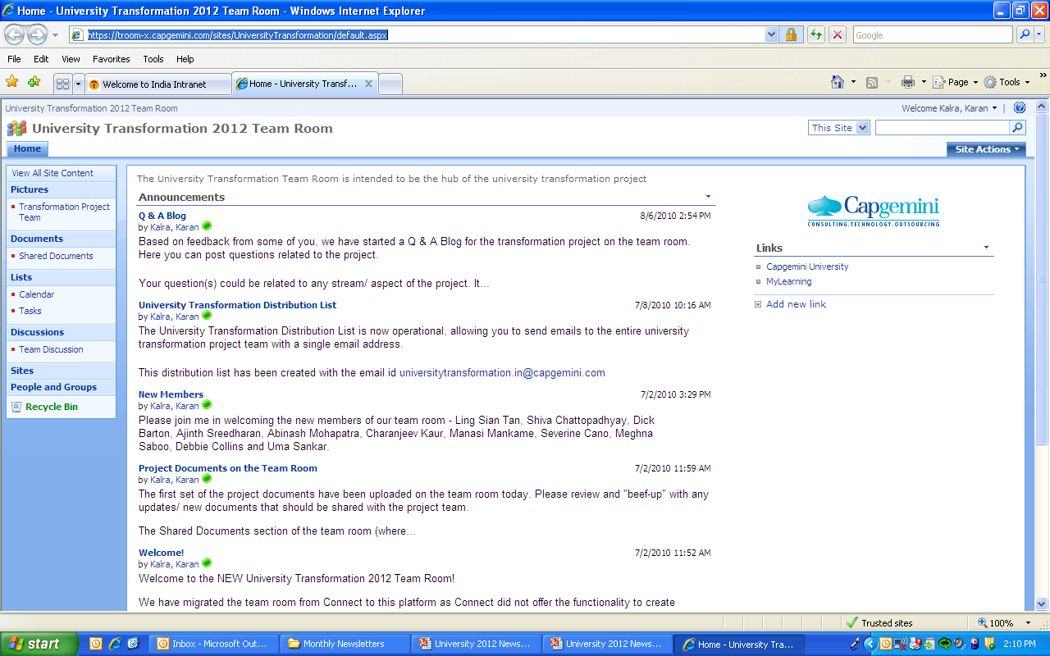
Transformation Project Team Room
The Transformation Project Team Room houses all the documents related to the University Transformation Project. It also contains important announcements, a calendar of upcoming events and pictures of the project team.
Recently, we have also started a Q&A Blog where you can post any questions related to the project and we will answer them through the newsletter. Many thanks to Dick Barton for being the first to post his question... Answer on the following pages Dick!
Unfortunately, many of you have not even visited the team room, let alone use it.
I encourage you visit and use the team room at I encourage you visit and use the team room at https://troom-x.capgemini.com/sites/UniversityTransformation/default.aspx
Capgemini University 2012
8

Slide 10
Q & A (1 of 4)
As you already know, we recently started a Q & A Blog on the team room and promised to give you answers through the newsletter. We said we would make a start with the questions collected during the transformation project workshop in Les Fontaines on 20th July, and grouped your questions into 4 categories – Funding, Governance Model, RACI/ Role Descriptions and New University Organisation. In this issue, Marijke Dekker answers your questions around Funding and the Governance Model. Your questions regarding Funding were as follows:
1. Who pays for:
New Curriculums?
Development activities?
Delivery / Tuition?
2. How do we balance requirements vs. the reality of funding?
Answers: During the University Directors call last Friday the 3rd of September we addressed that the construction of the budgets in the upcoming months will be done in the same way as we always did. The new structure of the University is not implemented yet, so that’s logical. So all Directors will work till December on the budgets as usual!
A help will be that we already have started to create Learning Plans with most of the SBU’s/BU’s. This will result in a clearer overview than we ever had on development needs across Capgemini and demand (delivery needs). That is already a positive outcome of our new way of working! We know that the picture will not be complete and can change over time, but that is business as usual for us (and everybody, because that is the same case with the budget planning in the business).
Capgemini University 2012
9

Slide 11
Q & A (2 of 4)
Regarding development, it is the same process as we are having now, but this year already starting to be more professional. To prioritize the development needs (for a new curriculum or other development) a business case for the request needs to be written and with that in hand we will prioritize the requests.
To help us with that we’ve built (and tweaked lately) a template for writing Business Cases and a new Request Management Tool; we are piloting the adjusted template and tool since a few months. The challenge is to Keep It Simple (KIS)! The development request accompanied by an advice from the University will go as usual to the University Board. They will decide how much funding we will go for which development needs. An SBU/BU can also decide to fund some development themselves as has happened in previous years. The roles involved in that process are defined in the RACI.
Regarding a whole new curriculum some other process needs to be done first. Namely the Curriculum Board needs to agree that there is a need for that new curriculum. After that the same process will follow as just described.
Then the payment for delivery. As said before we will have more visibility resulting from the Learning Plans on the demand across SBU’s/BU’s and Curricula. The University Directors will receive the demand for their curricula discussed in their SBU Council members and defined in all the Learning Plans. This year the University Directors will construct the delivery budgets for the Curricula they are managing and will set up the calendar for the upcoming year. In the new situation the same activities on demand management will be done by the entity “Learning Demand Management” and “Operations” together. The delivery will now and in the future be paid via tuition fee from participants. Next year “Operations” will take care of the organization and financials of the delivery including the reporting for the Monthly Reviews.
Capgemini University 2012
10

Slide 12
Q & A (3 of 4)
Your questions regarding the Governance Model were as follows:
How do we manage interactions between SBU / BU councils and Curriculum Board / Councils?
How are the links between Curriculums managed?
How de we bring SBU/BU Councils together?
What is the relationship between University Management and the other 3 triangles in the University Governance Model?
Answers: In the last couple of months we have defined the functions needed in the SBU/BU Councils and targeted the persons responsible for that functions in each SBU/BU. The SBU/BU Councils have as a main job to create their Learning Plans. Not only for University training, but all their training. The Business defines their challenges, training needs and budgets. The L&D responsible defines together with the University member in that Council what training is already there and what is missing (either global, regional, local or virtual). This will be written down in their individual Learning Plan. All the Learning Plans together result in an overview of development and delivery needs for training in each curriculum.
The development needs for one curriculum will be shared by the entity “Learning Demand Management” to that specific Curriculum Council. That Council will decide what makes sense to develop and will create the Business Case for the development request for the University Board as mentioned in my previous column. As mentioned there: a request for a new Curriculum goes first to the Curriculum Board, since the Curriculum Board is about managing across curriculums and is also the link between Curriculums (if there is any…)
And last but not least; The relationship between the 3 Governance Bodies and the University? We are in the middle, because In each corner of the triangle the University is represented. Steven in the University Board, Account Directors in the SBU/BU Councils and Curriculum Directors in the Curriculum Boards.
Capgemini University 2012
11

Slide 13
Q & A (4 of 4)
We also had a question from Dick Barton posted through the team room. Dick’s question was as follows:
I understand we have an aim of being the no. 1 Corporate University. That's great! But what are the criteria? Who's judging?
Thank you for your question Dick. It’s a good one… and one where the answer will evolve over time. For the moment, our answer is as follows:
It is our ambition to become the No.1 Corporate University in the world and our success in this regard will be judged by the outside world.
The University Excellence function (within the new university organisation structure) will be responsible, among other things, to develop our value proposition with the outside world. This includes
the development and management of relationships with external learning bodies, such as the EFMD, CLO, Corporate University Exchange
the development and management of relationships with academic institutions, such as INSEAD and Wharton
identifying and targeting external recognition (awards, publications, conferences)
Please visit the Team Discussion section of the Team Room to post more questions!
Capgemini University 2012
12

